Slide 1
GERM THEORY OF DISEASE

Slide 2
Germ Theory of disease
The combined efforts of many scientists and most important Louis Pasteur and Robert Koch established the Germ theory of disease.
The idea that invisible microorganisms are the cause of disease is called germ theory.

Slide 3
Lord Joseph Lister(1827-1911)
Famous English surgeon is known for his notable contribution to the antiseptic treatment for the prevention and cure of wound infection.
He also devised a method to destroy microorganisms in the operation theatre by spraying a fine mist of carbolic acid into the air , thus, producing an antiseptic environment.
Joseph Lister is known as the Father of antiseptic surgery.

Slide 4
Robert Koch
The first direct demonstration of the role of bacteria in causing disease.
German physician who first of all isolated anthrax bacillus( Bacillus anthracis, the cause of anthrax) in 1876.
He perfected the technique of isolating bacteria in pure culture.
He also introduced the use of solid culture media by using gelatin as a solidifying agent.
He discoverd Mycobacteria tuberculosis.

Slide 5
Koch’s postulates
Koch’s postulates were published in1884 and are the corestone of the germ theory of diseases and are still in use today to prove the specific cause of an infectious disease.

Slide 6
Koch postulates are:
The suspected microorganism must always be found in diseased but never in healthy individuals.
The microorganism must be isolated in a pure culture on a nutrient medium.
The same disease must result when the isolated microorganism is incubated into a healthy host.
The same organism must by reisolated from the experimentally infected host.

Slide 7
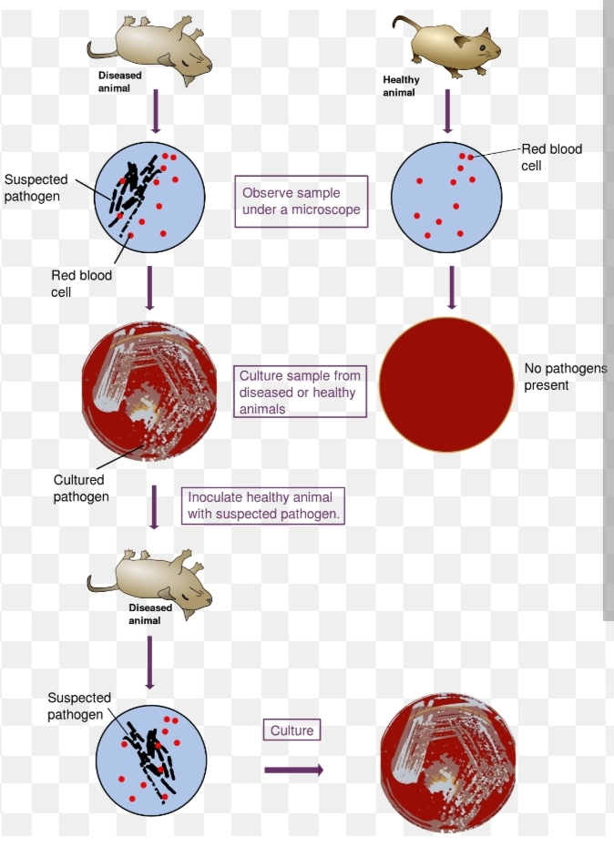

Slide 8
Fanne Eilshemius Hesse( 1850-1934)-
one of Koch’s assistant first proposed the use of agar in culture media. Agar was superior to gelatin beacuse of its higher melting (96 ˚C ) and solidifying(40-50˚ C) temperature points than gelatin and was not attacked by most bacteria.

Slide 9
Richard Petri(1887)- developed the petri dish (plate) , a container used for solid culture media.
Thus contributions of Robert koch, Fannie Hesse and Richard petri made possible the isolation of pure cultures of microorganisms, and directly stimulated progress in all areas of microbiology especially medical microbiology.

Slide 10
IMMUNIZATION

Slide 11
Immunization
During the course of some infectious diseases, the body develops resistance to further attacks by the same pathogen, referred to as immunity.
Immunity can be introduced by introducing harmless living, weakened(attenuated) variants or inactivated bacterial toxins (toxoids) into the body, which consequently develop immune response without acquiring the disease. This procedure, termed as vaccination.

Slide 12
Edward Jenner(1749-1823): an English physician to prevent smallpox.
He discovered the technique of vaccination.

Slide 13
Elie Metchnikoff (1845-1916): proposed the phagocytic theory of immunity in 1883.
He discovered that some blood leukocytes, white blood cells (WBC), protect against disease by engulfing disease causing bacteria.
These cells were called phagocytes and the process phagocytosis.

Slide 14
Behring and Kitasato: provided evidence that immunity could develop from soluble substances in the blood, now referred to as antibodies (humoral immunity)

Slide 15
CHEMOTHERAPY AND WONDER DRUGS

Slide 16
Paul Ehrlich(1854-1915):
In 1904 found that the dye Trypan Red was active against the trypanosome that causes African sleeping sickness and could be used therapeutically. This dye with antimicrobial activity was referred to as a ‘magic bullet’.
Ehrlich in a collaboration with Sakahiro Hata , introduced the drug Salvarsan(arsenobenzol) as a treatment for syphilis caused by treponema pallidum.
Ehrlich was pioneer in the development of chemotherapy for infectious disaese.

Slide 17
Alexander Fleming:
He discovered the penicillin from penicillium notatum that destroy several pathogenic bacteria.
Alexander Fleming, Sir Howard W. Florey and E.B. Chain shared the Nobel prize in 1945 for the discovery and production of penicillin.

Slide 18
S.A. Waksman: Streptomycin produced from Streptomycin griseous in 1944.

